Slide 1
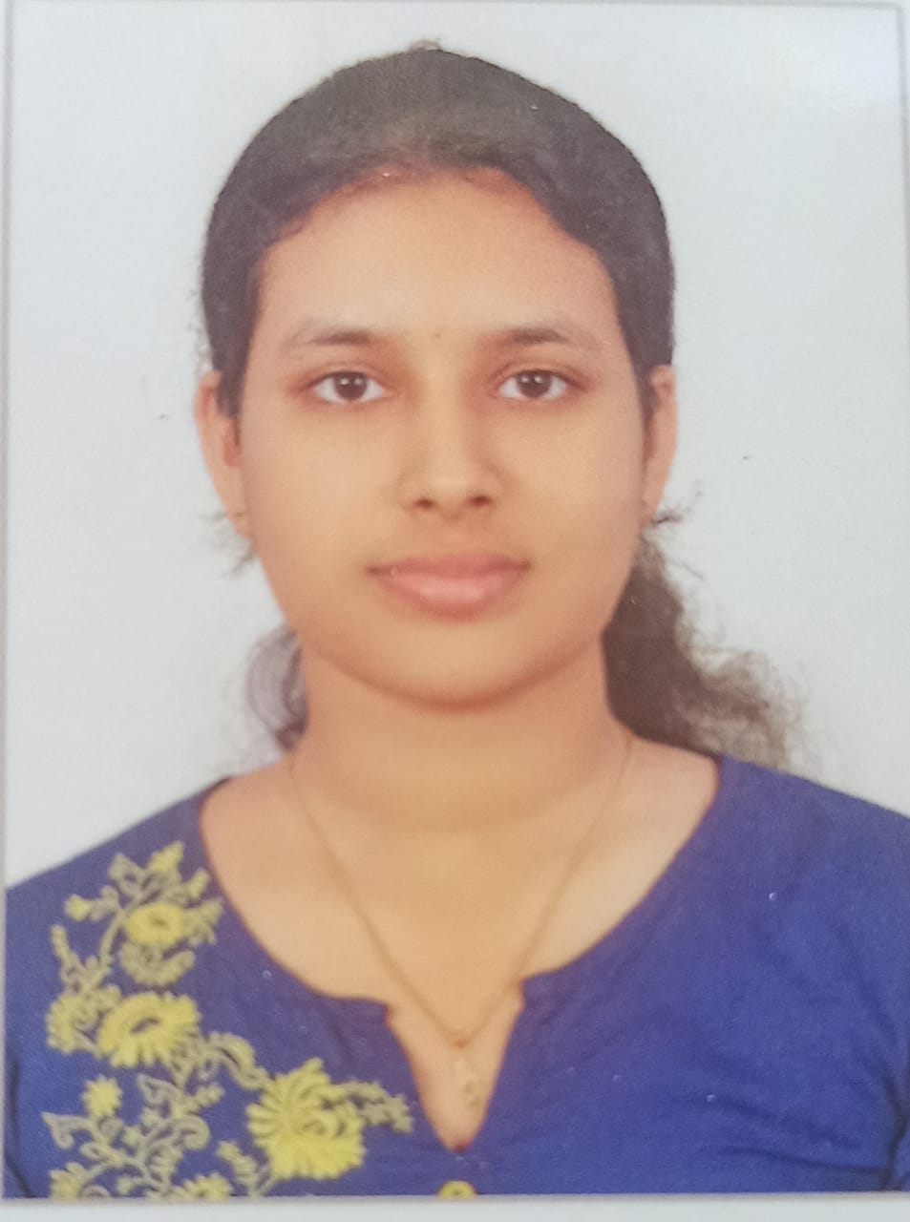

SWOT ANALYSIS
NAME : Nandana ts
Regd no : 12213477
Domain : b.tech cse
Job role : full stack developer

Slide 2
STRENGTHS
Teamwork and collaboration skills
Responsible
Time management

Slide 3
WEAKNESS
Critical thinking skills
Stage fear
Decision making

Slide 4
OPPORTUNITIES
Studying in LPU
To study coding , programming
To improve communication skills

Slide 5
THREATS
It’s a very competitive field
Technological changes
Data security

